Slide 1


Guide to Specific Learning Difficulties (SpLD) Assessment
A Specific Learning Difficulties (SpLD) assessment is a comprehensive, diagnostic evaluation that explores how your child processes information, learns, and manages academic tasks (like schoolwork).
It identifies any learning differences and helps develop tailored strategies to support your child's progress and performance. The process is collaborative, respectful, and focused on building insight—not a pass-or-fail test. This guide will walk you through what to expect before, during, and after your child's assessment, helping you understand how this process can empower your child's learning journey.

Slide 2

Types of Specific Learning Difficulties
Dyslexia
Characterized by difficulties with reading, spelling, and written expression. May include challenges with phonological processing, word recognition, and reading fluency.
Dyscalculia
Involves challenges with numeracy and understanding mathematical concepts. May include difficulty with number sense, arithmetic operations, and mathematical reasoning.
Dyspraxia (DCD)
Presents as difficulties with coordination and motor planning. May affect handwriting, physical activities, and organization of movements.
ADHD
Impacts attention regulation, working memory, and executive functioning. May manifest as difficulty maintaining focus, organizing tasks, or managing impulsivity.
It's important to understand that SpLDs do not reflect intelligence levels. Many individuals with learning differences have average or above-average abilities, with areas of significant strength alongside specific challenges.

Slide 3





Why Consider an Assessment?
Persistent Learning Difficulties
Your child has experienced ongoing challenges with reading, writing, organising, or remembering information despite their best efforts.
Inconsistent Performance
You've received feedback from teachers about your child's uneven performance across different tasks or subjects.
Understanding Your Child's Learning Profile
You wish to gain insight into your child's cognitive strengths and challenges to develop more effective learning and working strategies for them.
Accessing Support
Your child needs formal documentation to access accommodations in educational settings, for professional exams, or in future workplace environments.
An assessment can be transformative, providing clarity about learning patterns you and your child may have noticed throughout their life but never fully understood.

Slide 4

Virtual vs. Face-to-Face Assessment
Virtual Assessment
Face-to-Face Assessment
Convenience: Conducted from the comfort of your home, saving travel time and costs.
Direct Interaction: Allows for closer observation of non-verbal cues and direct engagement.
Flexibility: Easier to schedule around your child's routine.
Controlled Environment: Minimized distractions for focused assessment.
Accessibility: Ideal for families in remote areas or with mobility challenges.
Specific Tasks: Better suited for assessments that require hands-on activities or specific physical responses.
Environment: Familiar and less intimidating for some children.
Considerations: Requires a stable internet connection and suitable device. Potential for distractions at home.
Personal Connection: Some children may benefit from in-person interaction with the assessor.
Considerations: Requires travel to a physical location. May feel less comfortable for some children initially.
Both virtual and face-to-face assessments are designed to provide a thorough and accurate evaluation. The best choice depends on your individual circumstances, your child's comfort, and the specific needs of the assessment.

Slide 5






Who Conducts the Assessment?
Educational Psychologists
Professionals specialized in cognitive and educational assessment
Specialist Teacher Assessors
Educators with advanced qualifications in assessing specific learning difficulties
Clinical Psychologists
Mental health professionals with expertise in neuropsychological assessment
These qualified professionals have extensive training in administering and interpreting standardized assessments. Their reports are recognized by educational institutions, employers, and professional bodies for the purposes of support and reasonable adjustments.
When selecting an assessor, verify their credentials and ensure they're registered with appropriate professional bodies that maintain assessment standards.
At Defining Dyslexia, our assessors are highly qualified professionals with the highest level of specialist training and ongoing CPD. Each member of our team is not only experienced in identifying and supporting specific learning difficulties, but also committed to delivering person-centred assessments with care, clarity, and professionalism. All our assessors are fully accredited and registered with recognised professional bodies, ensuring the highest standards in every assessment we provide.

Slide 6



Information You'll Need to Provide
Developmental & Educational History
Information about early development, school experiences, academic achievements, and any previous assessments or support received.
Work or Academic Records
Samples of written work, reports, performance reviews, or academic transcripts that demonstrate patterns in your strengths and challenges.
Medical or Diagnostic History
Details of any relevant medical conditions, medications, or previous diagnoses that might influence learning or cognitive functioning.
This background information helps create a comprehensive picture of your experiences and needs. It allows the assessor to contextualize test results within your broader life history and identify patterns that might not be apparent from assessment tasks alone.

Slide 7





Assessment Format
Initial Interview
Discussion of your background, concerns, and goals for the assessment (30-45 minutes)
Cognitive Testing
Series of standardised tasks measuring various aspects of cognitive functioning (60-90 minutes)
Break
Rest period to prevent fatigue and maintain optimal performance (15-20 minutes)
Academic Testing
Tasks specific to reading, writing, and/or math skills (30-45 minutes)
Debrief
Brief discussion of observations and next steps (15-20 minutes)
Assessments typically last 2 to 3 hours total, including breaks. The format may vary slightly depending on your specific concerns and the assessor's approach. The session can be conducted either in person or online, with accommodations made for your comfort and optimal performance.

Slide 8



Preparing for an Online Assessment
Technical Setup
Ensure stable internet and functioning equipment
Environment
Secure a quiet, private space free from interruptions
Materials
Gather required tools and assistive technologies
Before your online assessment, test your technology to ensure everything works properly. Position your camera so the assessor can see your work area. Have paper, pens, and any assistive technology you normally use (like colored overlays) readily available.
Consider letting household members know you'll need privacy and quiet during the scheduled time. If possible, close windows to minimize external noise and ensure your space is well-lit so the assessor can see you clearly throughout the session.

Slide 9
During the Assessment
1:1
0
100%
Personalised Attention
Time Pressure
Support Level
Individual assessment allowing for adaptive testing and observation
Most tasks measure quality of performance, not just speed
Clear instructions and guidance provided throughout
The assessment environment is designed to be respectful, calm, and supportive. You'll complete a variety of tasks, with the assessor guiding you through each one. Instructions are clear and straightforward, and you're encouraged to work at your own pace, with breaks provided as needed.
Remember that there are no "right" or "wrong" answers—the goal is to understand your unique cognitive profile. If you're unsure about anything during the assessment, don't hesitate to ask questions. The assessor is there to ensure you have the best opportunity to demonstrate your abilities.

Slide 10
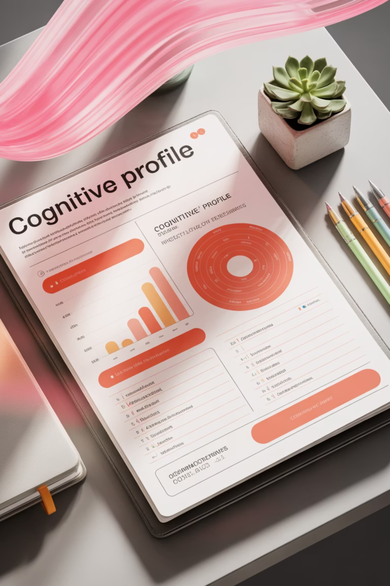




Understanding Your Assessment Report
Cognitive Profile
Detailed analysis of your cognitive strengths and challenges, including processing speed, working memory, and verbal reasoning
Diagnostic Conclusions
Clear statements about identified learning difficulties, with explanations of how they affect your learning and performance
Personalised Recommendations
Specific strategies, accommodations, and support options tailored to your unique profile and context
Support Access Information
Guidance on using the report to access institutional support, funding, and accommodations
Your report remains valid across all stages of life and can be used to access Disabled Students' Allowance (DSA), workplace accommodations (via Access to Work), exam arrangements, and other adjustments. The report is written in accessible language but includes the technical details needed by institutions.

Slide 11
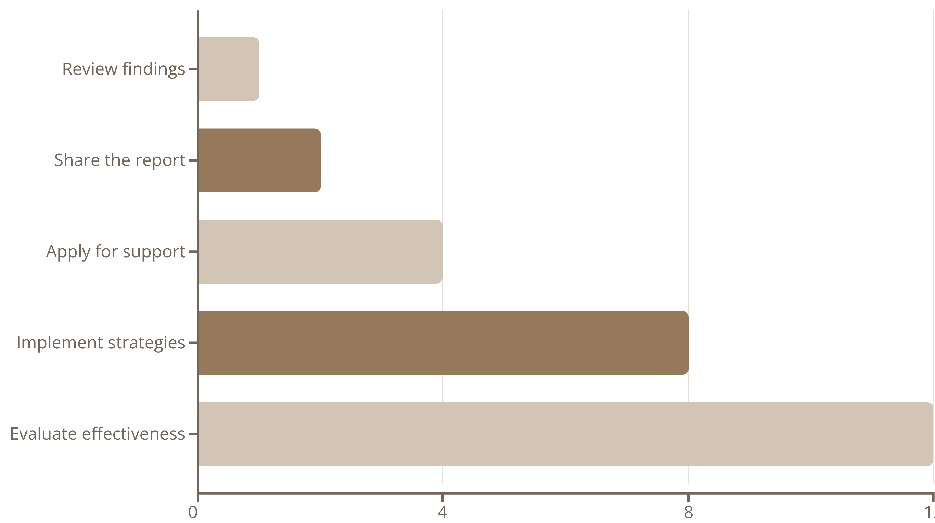
Next Steps After Your Assessment
After receiving your assessment, schedule a follow-up meeting with your assessor to discuss the findings and clarify any questions. Share the report with relevant departments at your university or with your employer to implement recommended accommodations.
Begin using the suggested strategies in your daily work or study routine, starting with the most immediately applicable recommendations. Keep track of which strategies work best for you, as you may need to adjust approaches over time. Remember that implementing new learning strategies is a process that requires patience and persistence.

Slide 12








Moving Forward with Your SpLD Diagnosis
Self-Advocacy
Confidently communicate your needs in academic and professional settings
Support Network
Connect with resources, communities, and assistive technologies
Learning Strategies
Implement personalised techniques that leverage your strengths
Self-Understanding
Recognize how your brain processes information differently
An SpLD assessment is not just a diagnostic tool but a pathway to empowerment. By understanding your cognitive profile, you gain valuable insight into why certain tasks have been challenging and how to approach them differently.
Many adults report that their diagnosis brings a sense of relief and validation, replacing self-doubt with a framework for understanding their experiences. With appropriate support and strategies, you can harness your strengths while effectively managing challenges, allowing you to thrive academically, professionally, and personally.

